Slide 1
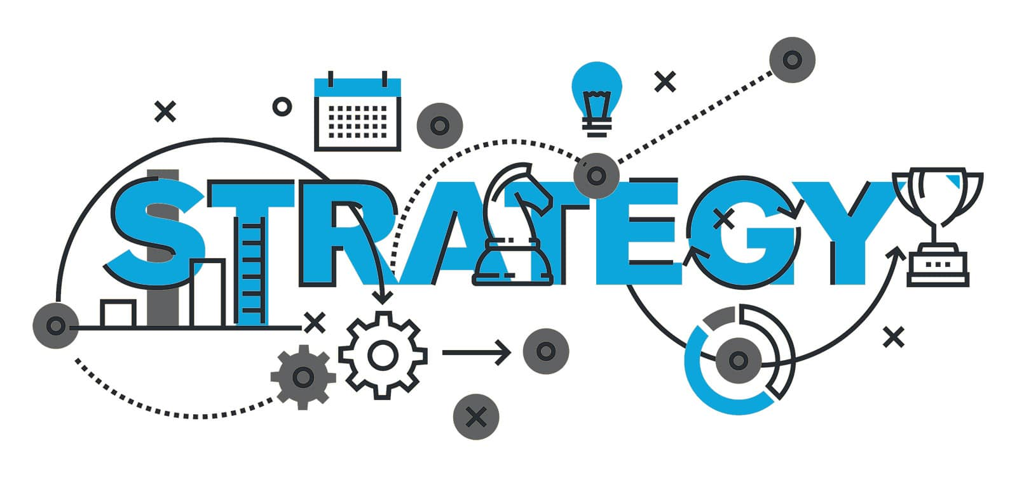
Product Management
Brought to the Program Areas
UNCLASSIFED / NON CLASSIFIÉ
Notes:
What we want is share our perspective. You’ll be hearing my voice but we have been working closely with other teams, like our BPMO and the EPMO. We’ve studied the subject by interviewing different parties (within and outside ESDC, both government and industries).
There’s a lot of different perspectives AND expectations of what “product management” means to people. If you have an ITIL background, that’s not quite it. If you read the IT Revolution book series or the Open Group’s Digital Practitioner BoK it has concepts, and the think thanks like Gartner… they focus on commercial industries.
What we seek to do is bring product management to ESDC Program Areas that are accountable to a democratically elected parliament, understand WHY it is needed, and WHAT actually changes (so it’s not just fluff, but something that can actually be implemented).

Slide 2
Purpose
We seek to:
Provide ESDC with a new type of investment: Product-based funding
Provide LOBs with needed guidance in transitioning to product management
Why:
Deliver Software at the pace of relevance
Integrate Business and IT Strategies
Release internal IITB capacity towards innovation
Avoid chronic underinvestment in IT infrastructure
Notes:
[transition] It brought us to provide ESDC two things:
[transition] A new type of investment using product-based funding
This because ESDC currently recognizes only three types of investments: assets, acquired services, and projects. (Source CFOB Guide to Building a Business Case: https://gpp-ppm.service.gc.ca/sites/pwa/ESDCKnowledgeRepository/All%20Documents/Guide%20to%20Building%20a%20Business%20Case.pdf)
If a Program wants to incorporate product management as part of a TB submission, there is no mechanism that exists to do it. They have to go the Project path. But a Project ends and seeks certainty before execution starts.
An actual statistic from our own Project Centre is that it takes, on average, 1,291 days to START the execution phase of a project. An organization can’t claim it’s Agile if it takes 3.5 years to start work.
[transition] Needed guidance to Programs in transitioning to product management after a project ends
Some of that exists right now. E.g. MyEMS(SAP) with IITB ERP team is doing it
But the knowledge on how to proceed and how it relates to Project Management is not broadly available.
[transition] There are 4 reasons why we want to do this:
[transition] Deliver Software at the pace of relevance. “The Business” (that is, Programs) is complaining we are too slow and that it is too burdensome to deal with the Branch.
[transition] Integrate Business and IT Strategies. It is currently extremely difficult to predict the needs of Programs. Likewise, Programs are having difficulty adequately communicating their needs to us. You’ve probably been double, if not tripled book, to meetings with 70+ attendees right? This is a symptom of the complexity Programs deal with.
[transition] Release internal capacity towards innovation. We do NOT seek to reduce costs here, we seek to create the necessary space for continuous improvements by reducing SOME of the overhead our internal capacity currently deals with
[transition] and… Avoid chronic underinvestment in IT infrastructure. Something that even BDM, by promising a modern one, is not scoped to solve.

Slide 3
Three key stakeholders involved
PROGRAM OFFICIAL
CFO
CIO
SEEN BY
PROGRAM OFFICIAL
SEEN BY
CFO
SEEN BY
CIO
Notes:
[transition] In our federal government context, we see three main stakeholders involved: the Program Officials, the CFO, and the CIO.
[transition] Each perceive the other differently. It’s normal, they are governed by different rules, affecting their behaviours and perception.
[transition] The Program Official is accountable to its Program’s key performance results. And ESDC has 50 of those programs.
[transition] The CFO and CIO are accountable to Corporate Policies (like the 509 policy requirements for the CIO. Because at ESDC, the CIO is also the official responsible for cyber security).
[transition] These corporate accountabilities require managing large demands on a limited amount and swamped resources (that is… people). If Programs do not see Corporate as a stakeholder, they make it harder to navigate those corporate rules and risk missing important opportunities to make even modest changes to Program Delivery agenda.

Slide 4
The Bigger Picture
Programs
Evaluated by Policy on Results
Demand
Internal
Services
< 15% of A-Base allocated to Projects
IITB Total Budget
Projects are used to compete for limited resources
A-Base
B-Base
Program Officials, CFO, and CIO share Accountability for Results
Notes:
[transition] We can visualize the relationships between Programs and IT as the typical iceberg. Programs see what is above water and wonder why it’s so slow to move.
[transition] Well, because they don’t see what is under the surface.
Likewise, if what is under the surface is too deep or spends too much time there, it may forget that the stuff above the surface is ultimately what ESDC is being held accountable for to parliament. [transition]
And to get results, delivery matters.
With the new Policy on Service and Digital, Program delivery are expected to be digital first.
[transition] Business Operations are changing into digital operations. Changing digital operations will mean changing software. Increasing demand to Internal Services.
This relationship between the two surfaces of the same object is described in the Departmental Results Framework (DRF). The problem we see is that the DRF has a Program Inventory (describing all 50 programs of the department) and this thing called “Internal Services”. Although the DRF says that Internal Services is horizontal in nature, it can too often be interpreted by Programs as “Tech is not my concern”.
[transition] This is a problem. If in their periodic program renewal activities, Programs do not seek sufficient funding to sustain their digital operations, it affects their results. And when TB funding requests are predictably answered with a reduced budget response, difficult prioritization decisions have to be made. The way it’s being done right now is by bundling work into “Projects” and compete for those limited IT resources.
For common services that competition is FIERCE. A Pension System may have to commit to and coordinate dozens of projects at the same time (a11y compliance, work load migration, windows server upgrade, technical deb, business enhancement, legislation mandates, BDM). Each projects having a wide scope of change. It can become unrealistic for IT to manage and coordinate commitments of that scale on a single system. In addition, if the Pension Program did not sufficiently invested in its Pension system over the decades, it now suffers a lack of responsiveness affecting the Pension Program Results.
Departmental Results Framework: https://dialogue/grp/WG6278300/SitePages/Home.aspx
GCPedia’s Internal Services Portal:
https://www.gcpedia.gc.ca/wiki/Internal_Services_Portal
ESDC DRF sharepoint: https://dialogue/grp/WG6278300/SitePages/Departmental%20Results%20Framework%20-%20Cadre%20ministériel%20des%20résultats.aspx

Slide 5
Continuous Improvements vs Projects
FUNDING COVERAGE
RUN
Maintain Value
ENHANCE
Drive Value
Operate (Run)
Maintain Value
Enhance (Improve)
Drive Value
Innovate (Change)
Create Value
INNOVATE
Create Value
Operation and Maintenance
Run
Continuous Improvements
Small Growth
Innovate
Large Growth
Transform
A-Base Funding
B-Base Funding
Slide inspired from Jan 2021 presentation by MyEMS (SAP) CoE
Notes:
[transition] We seek to separate continuous improvements from Projects.
And by doing so, allow more autonomy to teams to perform certain small growth activities (e.g. typically improving existing business processes, enhancing user experience, addressing the SA&A’s residual risks).
Projects still exist. When there is a certain size of change needing to be managed (such as coordinating changes across multiple products, or when there’s a certain threshold of business operation change needed to be change managed). Projects are also the instrument Programs use to seek funding for such change.
That scale of change differentiating product enhancements vs projects is yet to be determined.

Slide 6
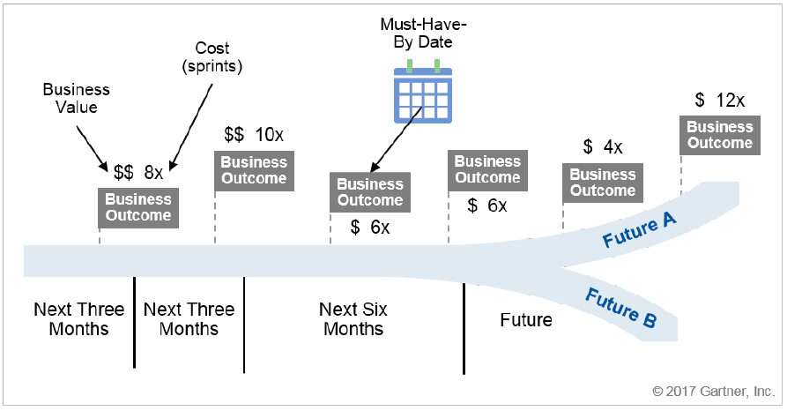
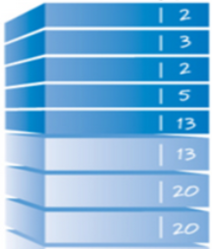
The Roadmap as the Plan
Project B
Project D
Project A
Project C
Backlog
Release Plan
Release Plan
Release Plan
Release Plan
Notes:
[transition] To organize these series of continuous improvements and project-specific requests affecting a particular product, the Product Roadmap is used. It’s the main negotiation instrument a Product Manager uses. It becomes the basis of accountability.
[transition] Projects compete against each other to change the product’s roadmap. Determining what change is more important at a point in time. Parallel projects, therefore, handle the coordination of changes to be applied on multiple different product roadmaps.
[transition] Those changes make up the product’s backlog
[transition] which informs the release plan on the product’s time horizon.
The Roadmap can and most likely will change depending on events. Because of reality. Parallel projects schedules would be expected to handle this change.
This all raises the importance of having strong Product Managers. We think this role will require a broad set of skills, especially leadership, as well as having both business and corporate acumen.

Slide 7
What a Product Management Framework provides
IITB Directive on Product Management
IITB Standard on Product Management
IITB Standard on Financial Coding for Product Management
IITB Procedures on Product Management
Notes:
[transition] The Product Management Framework we seek to produce comprises of:
[transition] A Directive.
To set IITB’s direction on how investments classified as “product”, by the EPMO, and how transitions from project to product are to be managed by the branch. This includes, for examples, roles and responsibilities, adherence to a set of standards, and consequences of non-compliance.
BTW, common definitions (e.g. “product”, “product manager”, “product owner”) is what the Project and Programme Management Practice Working Group is doing, lead by the EPMO.
[transition] Two standards: one on Product Management, and one on Financial Coding for product management
The first is to set IITB’s mandatory process for a consistent application of product management. It includes, for example, Technical Roadmapping Requirements, Budgeting agreement and securing sources of funds, corporate reporting requirements, Governance. Some of those standards would most likely point to existing processes.
The Financial Coding one is because we currently do financial coding as “run” or “projects”. Continuous improvement activities will require establishing financial coding and structure for activities performed under a “product status”.
[transition] Procedures on Product Management
This to guide stakeholders in navigating IITB’s Governance throughout the Product Development Life Cycle. For example: how to “seeking product status”, roles of each IITB corporate committees (and potentially updating their Terms of Reference).

Slide 8
A Branch Initiative to get things started
1
2
3
Job Bank
MyESDC
Notes:
[transition]
A Framework is but this: a set of documents. Change does not happen by producing documents.
We launched an 18 month Branch Initiative to produce the framework and evaluate it against 2 candidates: Job Bank and MyESDC Mobile App.
We know we are not going to get it right the first time, so the evaluation is to inform us of changes needed after having tried it.
One outcome of the BI is to inform a greater change management plan in bringing a Product Management Operating Model to ESDC. A lot of activities in this area are lead by EPMO.
The BI has 3 phases:
[transition] Phase 1 is the production of the framework. We seek engagement from 9 IITB divisions as it can’t be produced from an ivory tower. This phase will also seek contributions from CFO and TMB (Business Architecture).
[transition] Phase 2 is the evaluation of the framework. We’ll be following the 2 candidates in using the framework next fiscal year.
[transition] Phase 3 is updating the framework with the lessons learned and informing a greater change management plan in bringing a Product Management Operating Model to ESDC. A lot of activities in this area are lead by EPMO.

Slide 9
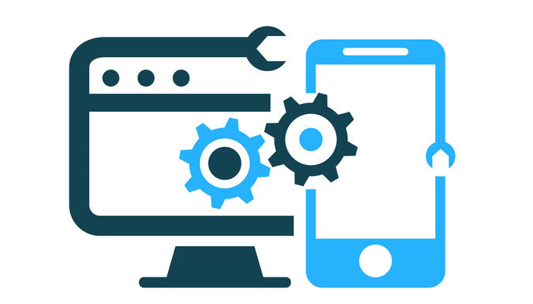
Links with other initiatives
DevSecOps
BDM
Technical Debt Remediation
IITB Way Forward Phase 2
Notes:
[transition] Other initiatives are currently under way that seeks similar goals. We seek to either leverage them or contribute to them.
[transition] DevSecOps: because a product management expects a certain cadence of delivery to be sustained (typically a release within 3 months), it favours the adoption of DevSecOps to maintain pace of relevance and continuously address cyber security risks. And we do mean SecOps, because of security at runtime, not JUST in the pipeline.
https://www.nist.gov/system/files/documents/2021/02/22/05%20-%20Nicolas%20-%20DoD%20Enterprise%20DevSecOps%20Initiative%20-%20Keynote%20Presentation%20v2.0-w%20ZT.pdf
[transition] Tech Debt: Transitioning to product management is expected to require agreement between a Program Official and the CIO to fund product teams allowing them to address technical debt as part of their continuous improvement activities. In addition, we suggest three key metrics that links technical debt to the product team’s velocity and the product’s quality (here, we point to the APM+ program).
[transition] BDM: BDM’s scope is transformation, which will end. It does not include solving the sustainability challenge post-Programme.
Product Management compliments BDM’s transformational agenda by preparing IITB to transition BDM’s Digital Solutions to managed products.
[transition] And Phase 2 of the IITB Way Forward: The recent IITB Re-Org is based broadly on the Product Management Model, with a concept of a portfolio centric delivery environment supported by common services.

Slide 10
Summary
Moving towards digital warrants us to adjust our planning and investment management methods
Provides sustainable funding over a time horizon
Adapts to changing organizational priorities
Grants more autonomy to teams
Increases service improvement cadence
Product
Thank you
Notes:
[transition] In summary.
As ESDC is digitizing its business operations, software becomes central. Product Management is where the software industry is going. It is starting to become the norm to the point where TBS OCIO, you probably already know this, has created a DG-level working group to study how it can be implemented in government, and the latest update to the Digital Operation Strategic Plan 2021/24 mentions product management in two strategic pillars.
[transition] Product Management brings:
Sustainable funding to teams, providing them with stability.
[transition] Adaptability to changing priorities. Because a Product Roadmap avoids being in a planning phase for too long, course corrections can be made without losing too much of the investment, and it mitigates project collision that can clog delivery.
[transition] Grants more autonomy to teams by delegating certain authorities to them and reducing the number of cooks in their kitchen.
[transition] Increase service improvement cadence by focusing on outcomes and results, over corporate planning documents.
Thank you for listening. We’re curious to know the questions you may have and what you think.

Slide 11
Draft definition of “Product”
A business output that is the result of a project used for continuous improvement on an existing solution or service, the value of which is realized and delivered as part of ESDC's Program mandate, services external or internal stakeholders, and delivers or improves business capabilities or client experience.
Draft definition from the Project and Programme Management Practice WG

Slide 12
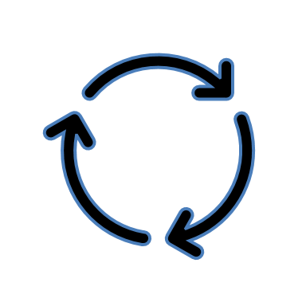
e.g.
Bi-yearly
e.g. Every 3 years or TB sub time horizon
New
Transition from Project to Product
Product Status Review
Changes in Product
Review
End of Life
Existing Artefact / Activity
Project Closure
Product Status Creation
Enterprise Alignment
Continuous Improvements
Update
Existing Process
Decommission
Stage 5
Project Closure
Step 1
Intake
Step 2
Initiation and Review
Step 3n: Release n
(Managing a Release)
Step 3n+1: Release n+1 (subsequent releases)
Step 4
Decommission
Governance → | MPIB / DGPOC | Sponsor & DGPOC/MPIB (depends on Budget amount) | Sponsor & DGPOC/MPIB (depends on Budget amount) | Sponsor | Sponsor | Sponsor | DGPOC/MPIB | Sponsor & DGPOC/MPIB
Responsible ↓ | Product Gating Artefacts
Product Manager |  | Product Brief Multi-Yearly budget Value Stream Map Cadence (schedule) Architecture Boundaries Product Governance Structure (Board) Source(s) of funds | Step-Base Product Roadmap Multi-Yearly Budget Key Product Metrics Conceptual Target Architecture Architecture Boundaries Benefits Realization Plan IRBV Archiving Checklist | Approval to Deploy Acceptance Report Product Workload Metrics | Approval to Deploy Acceptance Report Product Workload Metrics | Key Product Metrics | GO TO STEP 2 | Approval to Decommission Product Closure Report IRBV Archiving Checklist
FMA |  | FMA Attestation | FMA Attestation | FMA Attestation | FMA Attestation |  |  | FMA Attestation
Responsible ↓ | Product Supporting Activities
Product Manager |  |  | EARB review SA&A review | Produce Costing Tool Produce Release Schedule Evaluate Architecture Boundaries Change Management Risks and mitigation | Produce Costing Tool Produce Release Schedule Evaluate Architecture Boundaries Change Management Risks and mitigation |  |  | Produce Costing Tool Produce Schedule Document Lessons Learned Change Management
Product Owner |  |  |  | Release Scope Step-Base Product Roadmap (update) | Release Scope Step-Base Product Roadmap (update)
Product Team |  |  |  | Backlog grooming Evaluate Previous Release | Backlog grooming Evaluate Previous Release
Project Artefacts
Architecture Boundaries = Alignment to PIP and Business Capability Model, Privacy Impact Assessment, Statement of Sensitivity, Statement of Acceptable Risk, Algorithmic Impact Assessment (if AI used)

Slide 13
Product Roadmap as the Investment Plan
The Product Roadmap is the plan and basis of accountability
A Business Outcome is a mini-business case (1 pager) and the definition of success for a particular step
Funding based on priorities, not historical spending levels
The Roadmap can and will reprioritized or add new business outcomes to the roadmap due to experience gained with the product and to changes in departmental priorities
A roadmap is reality. Parallel projects feed Roadmap backlogs and will adjust based on the roadmap’s changes.
The path towards an outcome is not straight¹
Requires moving towards Continuous-type of ATOs and Monitoring²
Requires LOBs to accurately define business outcomes (promotes CDO/BAAO partnership)
¹ Requires a different set of metrics than project schedules due to iterative, empirical evidence seeking, process
² NIST and ITSG-33 do not have continuous types of controls. Need to innovate while remaining in compliance.
Notes:
Cost Estimates
Values the use of teams as a unit to calculate costs. Simplifies the cost estimates if 2 teams (@ $1M/year each) x 5 sprints of 2 weeks = $384,615
Product team focuses on the ROADMAP. Side project can influence the roadmap but when the roadmap changes, side projects need to adapt. I.e. there are no Change requests. Instead, there are Change events that projects need to handle.
WLM, Windows Server Upgrades, A11y Compliance, Tech Debt, Business Enhancement, BDM, etc. require to deal with change.

Slide 14
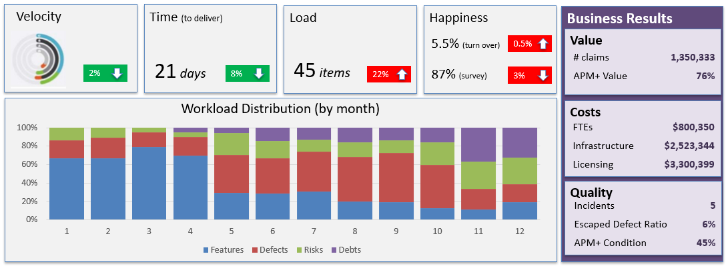
3 Key Metrics to provide assurances
Produced by the Product Team
Consumed by the Product Team, Business Sponsor, and Governance (DGPOC/MPIB)
Demonstrates progress towards Roadmap’s business outcomes
Includes Health Diagnostic metrics to address potential velocity issues (e.g. creeping technical debt)
Includes Workload distribution for transparency on focus
Includes Business Results which is ultimately what the Business and CFO cares about
Tied to a Program’s results
Business Results identification would benefit from strong collaboration with the CDO and BAAO
Notes:
Product development isn't the Wild West and teams do have metrics to measure how they are doing. These metrics focus on results and the trajectory toward objectives, rather than productivity
measures such as lines of code per day.
The team primarily shows its progress to the business through demonstrating working software and improvements with each iteration. It is responsible for its metrics and reporting them
to stakeholders. Metrics are reviewed at least at every sprint with business stakeholders as part of the retrospective. They may also be reported up to higher levels of governance as needed.
Sources:
Gartner G00338491 - Tell the CFO the Agile Team Isn't Asking for a Blank Check
Gartner G00309193 - Use the Right Metrics in the Right Way for Enterprise Agile Delivery
IT Revolution’s Project to Product book
Workload Distribution
Features: (visible to users) delivers New Business Value, pulled by Users, e.g. Epic, user story, requirement
Defects: (visible to users) delivers Quality, pulled by Users, e.g. Bug, incident, breaking change
Risks: (NOT visible to users) delivers Security and Governance, Compliance, pulled by Security and risks officers, e.g. Vulnerability, regulatory requirement
Debts: (NOT visible to users) removes impediments to future delivery, pulled by Architects, e.g. API addition, refactoring, infrastructure automation
Flow Metrics
Velocity: Number of flow items done in a given time. E.g. number of debts item resolved for a particular release.
Time: Time elapsed from when a flow item enters the value stream (state = active) to when it is released to the user (state = done). E.g. Time it takes to delivery a new feature to a user from when it was accepted.
Efficiency: The proportion of time flow items are actively worked on to the total time elapsed. I.e. a decreased efficiency is indicative of dependencies between teams waiting on others.
Load: Number of flow items with state = active or waiting (i.e. Work in Progress). Loads that exceed certain threshold adversely impacts velocity.
Business Results Metrics
Value: Benefit to the business the value stream produces. In the private sector, these would be tied to profit. However in the public sector, this metric changes between Digital Products and needs to be aligned to the ESDC Business Capability, Service, or Program’s desired outcomes that the Digital Product enables. The APM+ Business Value health indicator is included as well.
Cost: Cost of the Digital Product to ESDC. This includes the Value Stream’s staff salary, consultants, contractors, infrastructure, licensing, cloud subscriptions
Quality : The quality of the Digital Product perceived by the end user (e.g. escaped defects, tickets filed) and the APM+ Technical Condition Health indicator.
Happiness: Engagement of the staff working in the Value Stream (employee’s Net Promoter Score, ESDC HR Surveys, Public Service Employment Surveys).

Slide 15
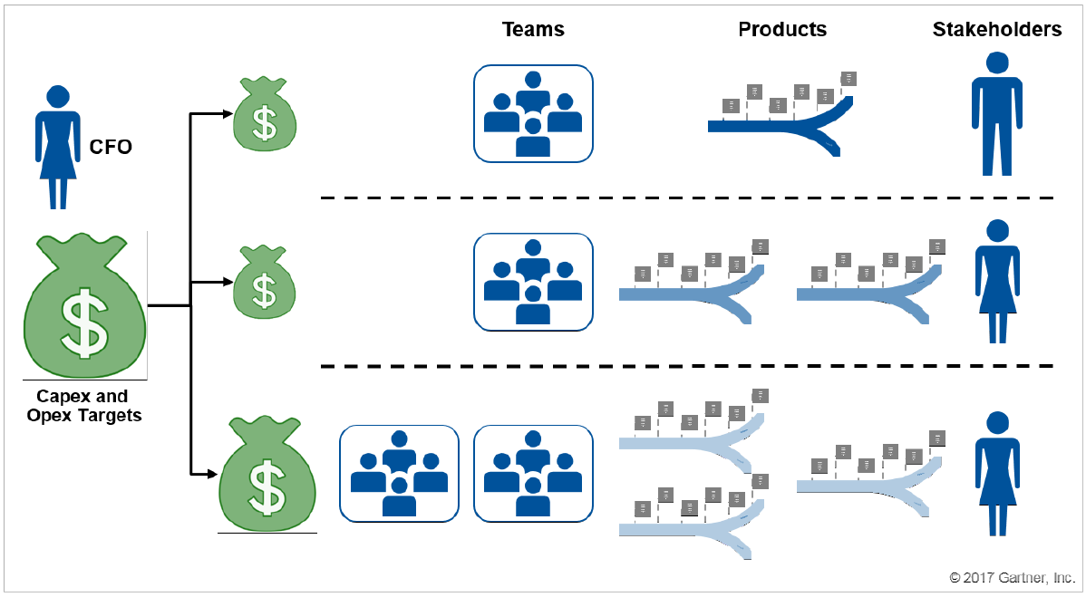
Portfolio Management & priority-based funding
CFO responsible for Budget, proportional to departmental and government priorities
Program Official responsible for fund according to her priorities
Program Official
(roadmaps)
CFO defines budgets based on ESDC priorities
Program Officials decide where the funds are allocated
Re-distribution of funds establishes new priorities for value stream teams
Increasing a product’s budget requires CFO engagement
Product A
Product B
Program’s portfolio Budget
Product C
Notes:
Instead of allocating spend to projects based on each project budget for the period, allocate it to products (or groups of products) for the period.
The allocation determines how many people and teams can work on any given product or product family. The job of the governance body is not to approve a project budget, but to
decide how to allocate the resources. As one CIO put it, "How much money should we be spending on this problem at this time?“
Gartner G00338491 - Tell the CFO the Agile Team Isn't Asking for a Blank Check

Slide 16
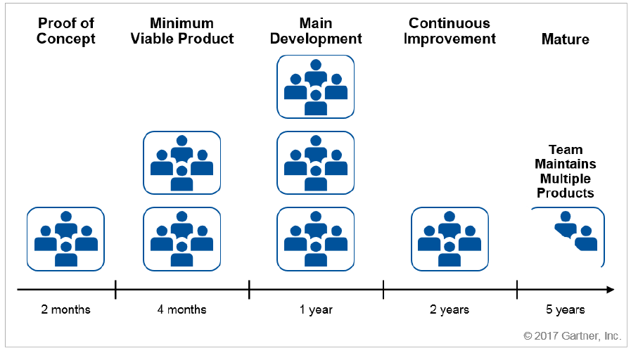
Value Stream Size vary during product’s life cycle
If product is a priority, more teams can be added to sustain development
Once product matures, work reduces to the minimum required until retirement
Value Stream team(s) work on more than one product
Products include exit strategies for value stream teams (e.g. when demand diminishes, teams are allocated to other products)
Pool of teams

Slide 17
Product’s Architectural Boundaries
(established at product status creation)
Reviewed as part of:
Product Roadmap’s periodic review
Internal Governance trigger (e.g. change in security classification, change in information collection)
Business Context:
Alignment to the Program’s Information Profile (PIP)
Alignment to the Business Capability Model¹
Accessibility Checklist
Information Profile:
Privacy (PIA, including retention & disposition),
Security (SoS, SAR),
Ethics (AIAs)
Technology Standard:
unacceptable technical stacks (in containment or retirement)
Product team responsible to produce the product’s target conceptual target architecture endorsed by EARB. Services from Solution Architecture of benefit to increase confidence.
Note 1: Application Architecture domain purposefully not included to provide more autonomy to product teams, accelerate delivery, and allow Enterprise Architecture to move towards a more strategic position (“doing the right things”). Promotes the use of Reference Architectures, inventory of re-usable open software products, and communities of practice (“doing things right”).
Note 2: Security Architecture a component of all architectural layers. Security compliance residual risks gets added to the product backlog and is part of daily work for the product team to remediate.
PIA = Privacy Impact Assessment SoS = Statement of Sensitivity SAR = Statement of Acceptable Risks AIA = Algorithmic Impact Assessment
Existing Artefact / Activity
¹ Using Enterprise Requirements Management at the business level
Existing Process

Slide 18
Value Stream
Definition
The individuals, irrelevant of where they fit within the org structure, that are part of the product delivery and operation (a grouping of cross-functional teams)
Handoffs greatly reduced if all individuals are under a single “Product Manager”
An implementation of the IITB SDLC
Value Stream (People)
Ideate
Create
Release
Operate
Planning
Engineering & testing
Release Mgt
Support, Monitoring, Ops

Slide 19
Infrastructure
(e.g. SSC, Cloud)
Tech Stack s/w Licences
Product A
Labour
(salary / non-salary
Direct Costing
Product B
CATS Codes
Source i
(e.g. TB sub i)
FMAS Documents
Allocation
Source ii
(e.g. EI Program)
Indirect Costing
Product Team Salary & non-salary
Corp Licences
(e.g. SaaS, s/w)
Common Cloud Services
Source iii
(e.g. CRF)
Real Estate
Common SSC services
Legend
Employee Benefits
Equipment
(e.g. laptops)
Cost Pool
Indirect costs shared by more than one cost object
Corporate Services
(e.g. Arch, Security Assessment)
Cost Object
Direct cost that is unequivocally attributed to a single cost object
Source
Source of fund that can pay for the product costs
Notes:
Common Cloud Services e.g.: networking (pipes)
Public sector organizations are required to report externally on the full cost of every element in their program architecture. In the meantime, such organizations also require multiple views of costs to manage effectively. The way to address these needs is through a mix of direct and indirect costing techniques.
The various views of cost are called cost objects - entities (activity, output, organization, program, client/target group, outcome, project) for which costs are being computed.
The costing system attributes a direct cost to its cost object and classifies indirect costs into cost pools through the correct financial coding of a transaction, using direction provided by the GC Chart of Accounts policy.
An example of a direct cost (definition: a cost that is unequivocally attributed to a single cost object) is the cost of a chemical used in a lab to conduct research in support of a particular organization or program.
An example of an indirect cost (definition: a cost that is shared by more than one cost object) is the cost of a photocopier used by multiple programs/organization. The assignment of indirect cost pools to cost objects is facilitated using existing operational data that managers already consider important and relevant – in the photocopier example, statistics can be obtained on how many copies were made by each organization/program over a particular time period.

Slide 20
Product Managers

